Slide 1
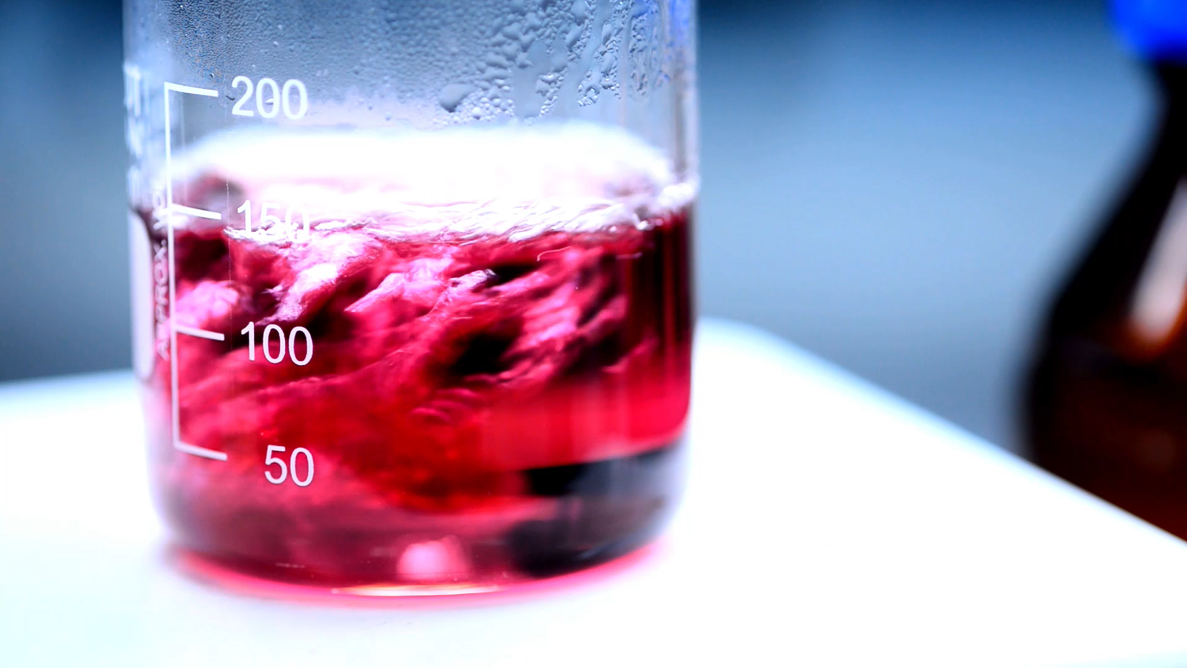
Red Wine Quality Analysis
Quality Feature Analysis

Slide 2
Red Wine Break Down - Agenda
Fixed Acidity, Volatile Acidity, Citric Acid – Rebekkah Alexander
Residual Sugar, Alcohol – Danita Charles
Free Sulfur Dioxide, Total Sulfur Dioxide – Bryan Thomas
Density, pH – Aaron Wood
Sulphates, Chlorides – Barry Maldonado

Slide 3
Title
[blurb inserted here to explain fixed what wine density and pH are and what they do]

Slide 4
Wine [Feature]
Logistic Regression accuracy was 24% [or .24?]
Decision Tree accuracy was 44%.
Random Forest accuracy was 45%.
Wine density is/is NOT an appropriate measure for predicting wine quality. Sufficient accuracy could not be obtained by the models targeting standalone physiochemical density.

Slide 5
Wine [Feature]
Logistic Regression accuracy was 24% [or .24?]
Decision Tree accuracy was 44%.
Random Forest accuracy was 45%.
Wine density is/is NOT an appropriate measure for predicting wine quality. Sufficient accuracy could not be obtained by the models targeting standalone physiochemical density.

Slide 6
Title
[blurb inserted here to explain fixed what wine density and pH are and what they do]

Slide 7
Wine [Feature]
Logistic Regression accuracy was 24% [or .24?]
Decision Tree accuracy was 44%.
Random Forest accuracy was 45%.
Wine density is/is NOT an appropriate measure for predicting wine quality. Sufficient accuracy could not be obtained by the models targeting standalone physiochemical density.

Slide 8
Wine [Feature]
Logistic Regression accuracy was 24% [or .24?]
Decision Tree accuracy was 44%.
Random Forest accuracy was 45%.
Wine density is/is NOT an appropriate measure for predicting wine quality. Sufficient accuracy could not be obtained by the models targeting standalone physiochemical density.

Slide 9
Title
[blurb inserted here to explain fixed what wine density and pH are and what they do]

Slide 10
Wine [Feature]
Logistic Regression accuracy was 24% [or .24?]
Decision Tree accuracy was 44%.
Random Forest accuracy was 45%.
Wine density is/is NOT an appropriate measure for predicting wine quality. Sufficient accuracy could not be obtained by the models targeting standalone physiochemical density.

Slide 11
Wine [Feature]
Logistic Regression accuracy was 24% [or .24?]
Decision Tree accuracy was 44%.
Random Forest accuracy was 45%.
Wine density is/is NOT an appropriate measure for predicting wine quality. Sufficient accuracy could not be obtained by the models targeting standalone physiochemical density.

Slide 12
Wine Density & pH
Wine density refers to the amount of dissolved solids (e.g. – sugars) dissolved in the wine. Dryer wines have lower densities than sweeter wines.
Wine pH refers to the acidity of the wine. Wine pH will impact the taste, color, and aging of the wine.

Slide 13
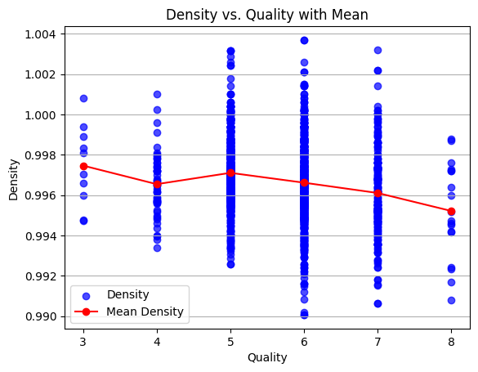
Wine Density
Modeled density for quality wine is .9948 g/mL.
Logistic Regression accuracy is 24%.
Decision Tree accuracy is 44%.
Random Forest accuracy is 46%.
Wine density is NOT an appropriate measure for predicting wine quality. Sufficient accuracy could not be obtained by the models targeting standalone physiochemical density and the mean may be just as useful within the density data

Slide 14
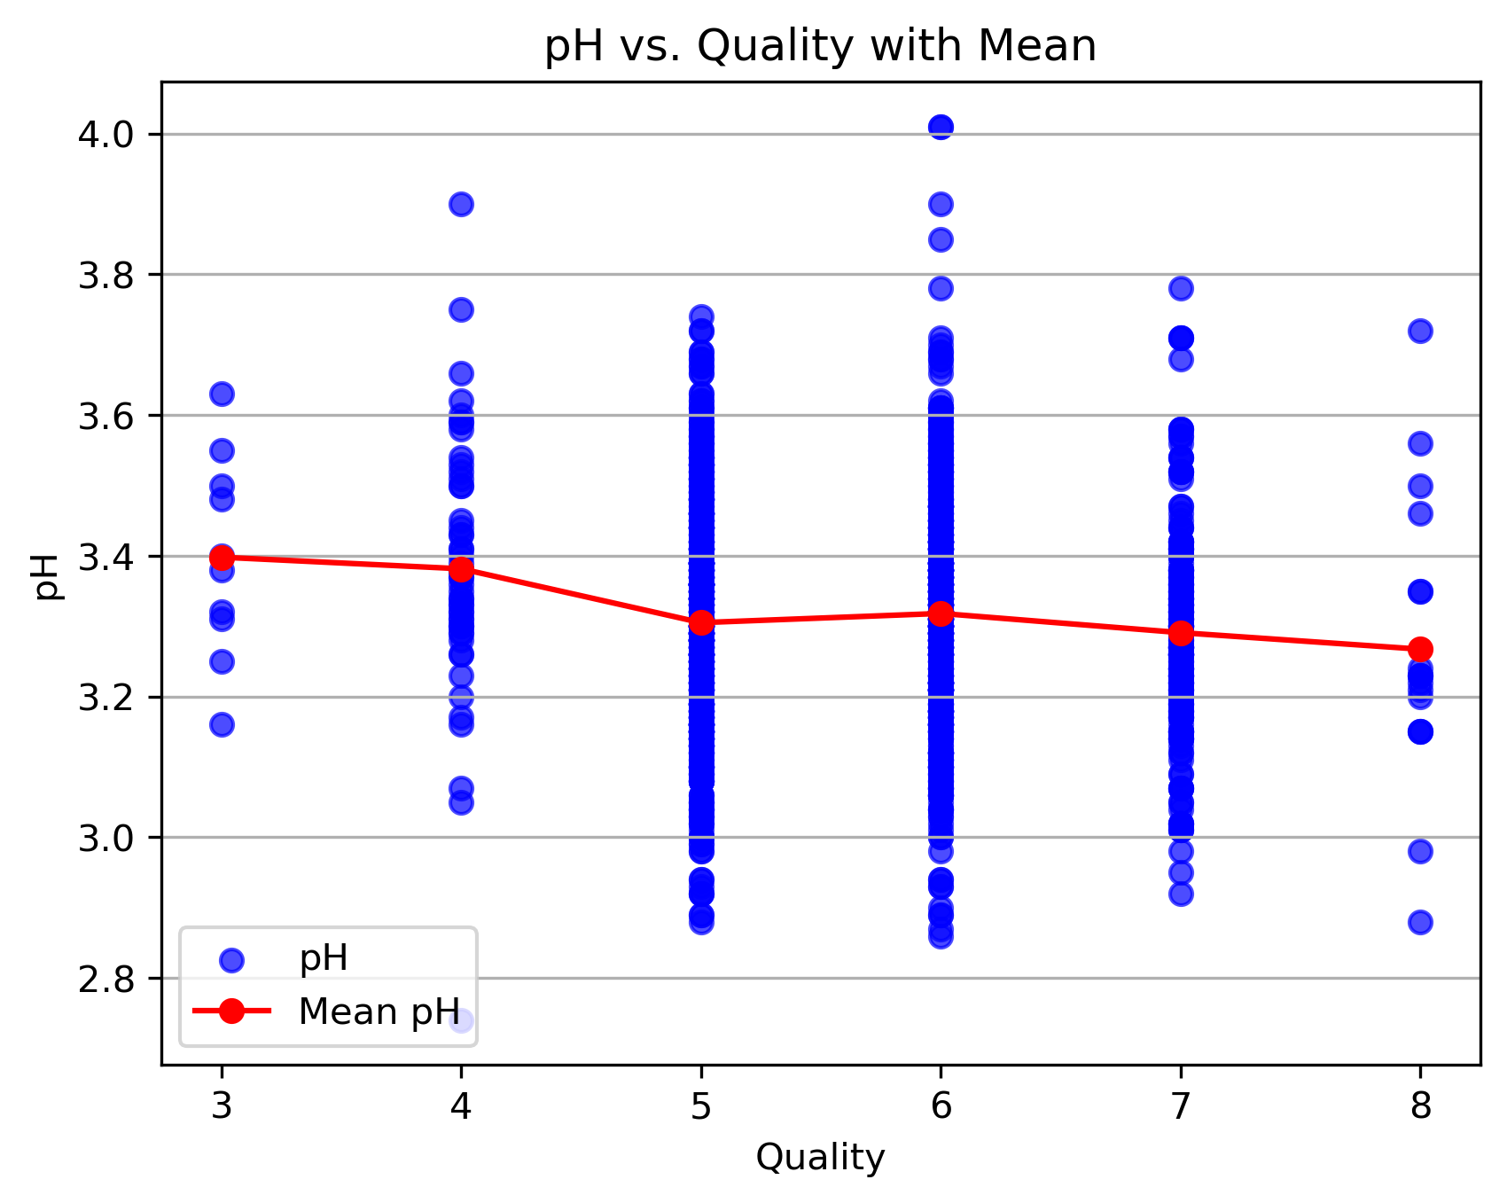
Wine pH
Modeled pH for quality wine is 3.25.
Logistic Regression accuracy is 24%.
Decision Tree accuracy is 42%.
Random Forest accuracy is 41%.
Wine pH is NOT an appropriate measure for predicting wine quality. Sufficient accuracy could not be obtained by the models targeting standalone physiochemical density and the mean may be just as useful within the pH data.

Slide 15
Title
[blurb inserted here to explain fixed what wine density and pH are and what they do]

Slide 16
Wine [Feature]
Logistic Regression accuracy was 24% [or .24?]
Decision Tree accuracy was 44%.
Random Forest accuracy was 45%.
Wine density is/is NOT an appropriate measure for predicting wine quality. Sufficient accuracy could not be obtained by the models targeting standalone physiochemical density.

Slide 17
Wine [Feature]
Logistic Regression accuracy was 24% [or .24?]
Decision Tree accuracy was 44%.
Random Forest accuracy was 45%.
Wine density is/is NOT an appropriate measure for predicting wine quality. Sufficient accuracy could not be obtained by the models targeting standalone physiochemical density.

